Slide 1
Problem C in Day 2:
Median Filter
Problem: H. Noda
Solutions: Y. Konishi and Y. Izumi
Slides: Y. Izumi

Slide 2
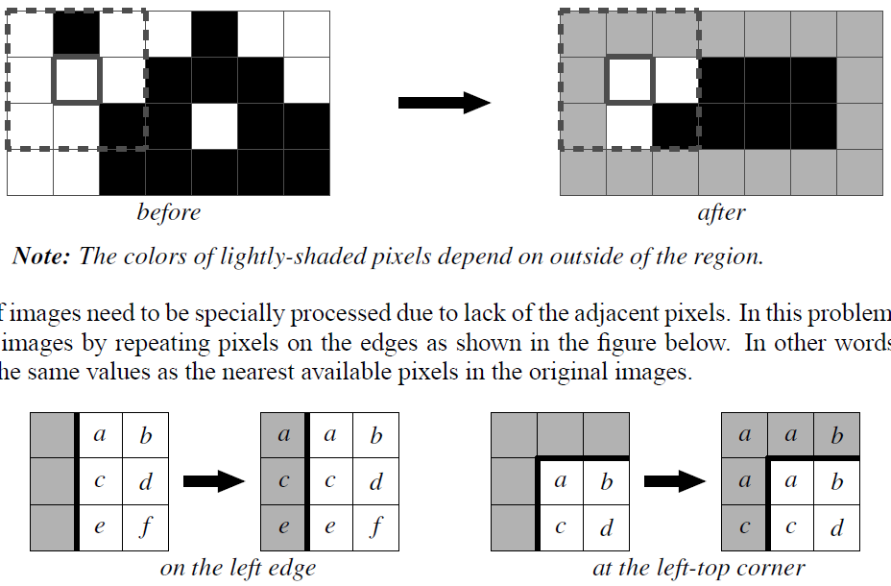
Problem in Brief

Slide 3
Summary
# Submissions : 5
  TwinTails (1), Wx (4)
# Acceptances : 2
  TwinTails (277 min), Wx (287 min)

Slide 4
How to Solve
Determine line-by-line.
  Each output scan line is affected only by the previous three scan lines.
Update the following:
  m_{i}[s_{i−1}][s_{i}] = min_{{s}} m_{i−1}[s_{i−2}][s_{i−1}]
  M_{i}[s_{i−1}][s_{i}] = max_{{s}} M_{i−1}[s_{i−2}][s_{i−1}]
  s_{i} = the i-th scan line
The answer is:
  max M_{H}[*][*] − min m_{H}[*][*]

