Slide 1
Problem A : Era Name
Draft : Noda
Solution : Yamaguchi,Yoshino
Comment : Yamaguchi

Slide 2
Constraint
Sorry!
  No constraints in the problem statement…
Constraints are these :
  1 <= N <= 1000
  1 <= Q <= 1000
  1 <= EraBasedYear <= WesternYear <= 10^9
  1 <= |EraName| <= 16
  1 <= Query <= 10^9
  Alphabets only.

Slide 3
Problem in Japanese
与えられること
  西暦でw年が元号sでe年
分かること
  西暦で w–e+1 <= y <= w の間は元号がs
やること
  元号と範囲を対応させるリストをつくる
  毎回リストを調べる => なければUnknown

Slide 4
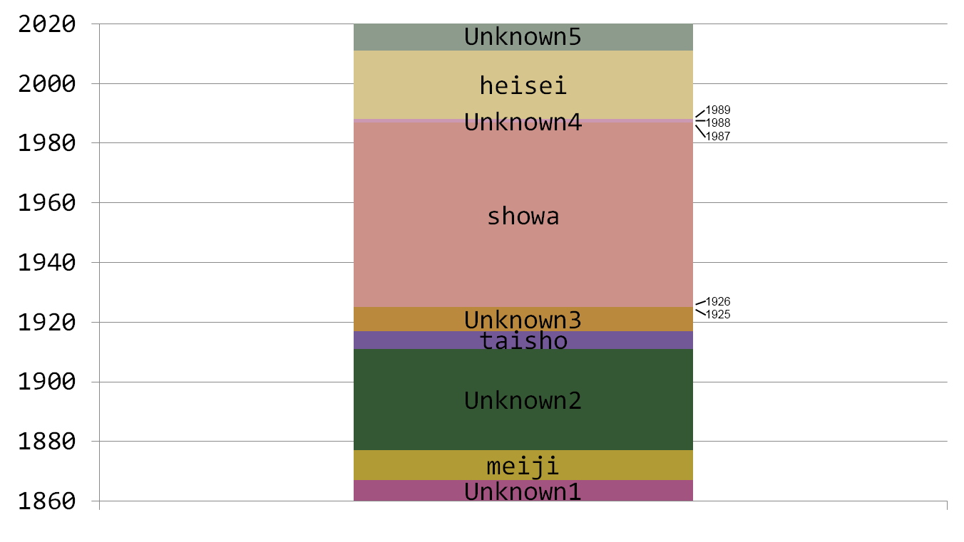
Sample Test Case 1

Slide 5
Etc.
Submit
  First Submit : 0x3f (13 min)
  First Accept : .Watch (14 min)
  Almost All Teams Accepted!
Judge’s Solution
  Yoshino : 70 lines
  Yamaguchi : 40 lines

