Slide 1
Cave Explorer
ICPC Japan Alumni Group.

Slide 2
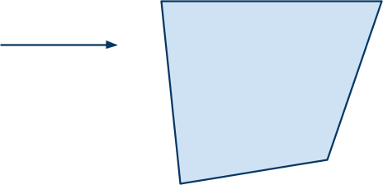
Problem
Given a polygon and a vector, cut the polygon in that direction.

Slide 3
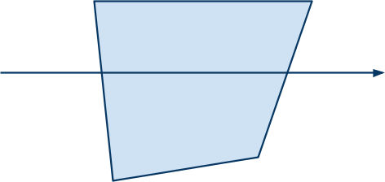
Problem
Given a polygon and a vector, cut the polygon in that direction, so that the area of the largest pieces is minimized.
The line divides the polygon by half, if the polygon is convex.

Slide 4
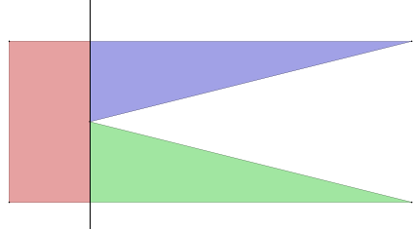
Examples.
The cutting line can pass vertices of the polygon.

Slide 5
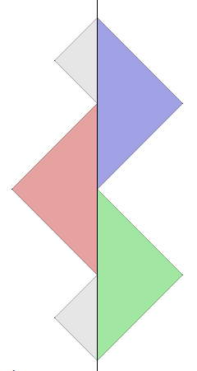
Examples.
The cutting line can pass vertices of the polygon.

Slide 6
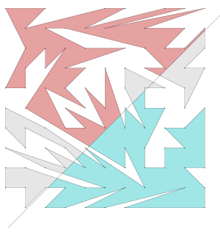
Solution. (1)
1. Fix the location of the line and calculate the area of the pieces of the polygon.
  Note that the pieces can touch the line multiple times.
  Should handle lines crossing the vertices.

Slide 7
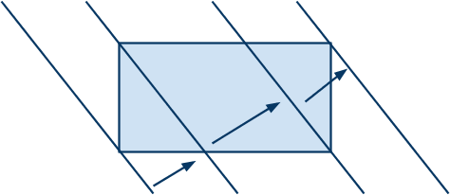
Solution. (2)
2. Find the right place for the line.
  Try all the candidates where the line touches any of the vertices.
  Sort the vertices by the distance to the line.
  Focus on each segment.
  The areas monotically increase/decrease when you move the line in the segment.

Slide 8
Solution. (3)
3. Find the right place of the line for the answer.
  1. Directly by analytics.
    All the areas are written in quadrics:). Just solve some equations.
  2. Numeric solution.
    The function f: line place -> maximum area is monotonic or has only one extremum (minimum.)
    You can find the minimum by Golden Section Search, for example.

Slide 9
Fight against calculation errors.
Should take special care on vertices * on line *.
  The minimum width of the segments is ~ 10-4.
  Should do Golden Section search in such thin areas:(
  Doing following algorithm is a bad thing.
const double EPS = 1.0e-10;
void onLine(line, point) {
return distance(point, line) < EPS;
}

Slide 10
Results
  Total submits: 0

